Slide 1
FATIGUE OF MATERIALS & STRUCTURES
G. Hénaff
1

Slide 2
HIGH CYCLE FATIGUE

Slide 3
Loading
Stress
1 loading cycle
σ_{max}
Maximum stress
Δσ
Stress range
σ_{a}
Stress amplitude
Time
σ_{m}
contrainte moyenne

Slide 4
Loading
Alternate Stress
Symetric alternate stress (R=-1)
Tensile alternate stress (R>0)

Slide 5
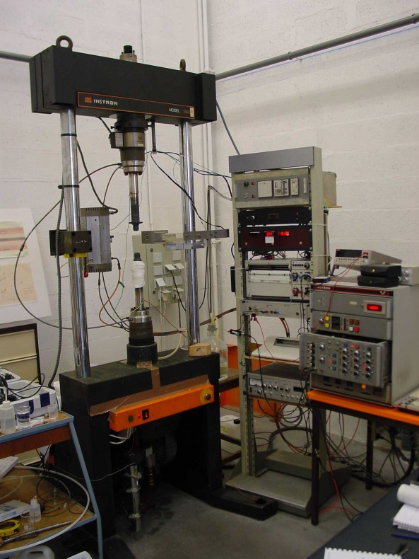
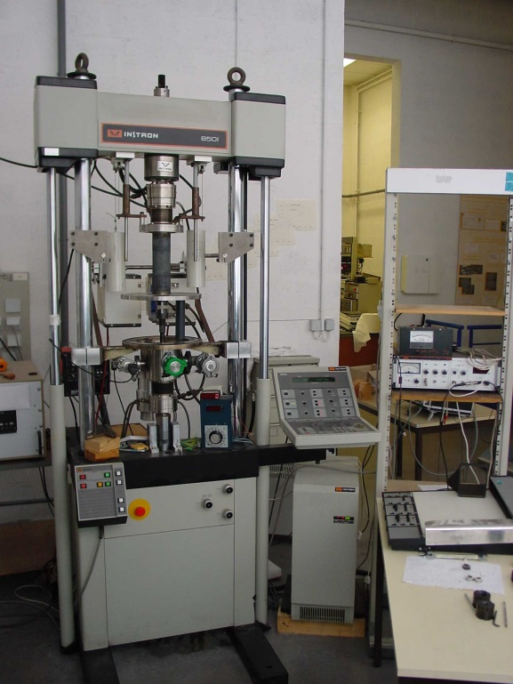
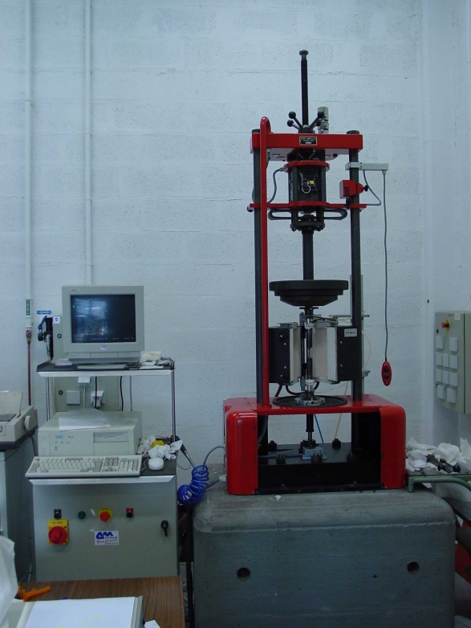
Testing Machines
Electro-mechanical : low cycle fatigue (f < 1 Hz)
Servo-hydraulic : high cycle fatigue, propagation
(f <50 Hz)
Resonant :
high cycle fatigue, propagation
(100 Hz <f <200 Hz)

Slide 6
Methodology
Fixed number of samples (geometry, surface);
Stress amplitude levels fixed prior to testing ⇒ number of test pieces tested per stress level;
For a given stress level, the distribution of lifetimes (number of cycles to failure) is determined.

Slide 7
Isoprobability curves
σ_{a}
Isoprobability curve 50% of failure
N
50
Number of cycles N

Slide 8
Wöhler Diagram

Slide 9
Endurance diagram
σ
σ
ε
a
R
σ
t
m
a
σ
a
Low-cycle Fatigue
Limited Endurance
σ
ε
Illimited Endurance
σ
D
Fatigue limit
10
2
10
4
10
6
10
8

Slide 10
Arbitrary fatigue limit
σ_{a}
Aluminum alloys, stainless steels, fatigue corrosion: no asymptotic behavior ⇒ arbitrary definition of the fatigue limit for a given number of cycles (10⁷ cycles, for example)
σ_{D}
N
10⁷

Slide 11
Limited Endurance
About 10⁵ to 10⁷ cycles
Empirical relations:
Weibull :
Basquin :
Bastenaire :

Slide 12
ε-N curve
Basquin
Manson-Coffin
N_{t} : « Elastic-Plastic » transition
c
b
N
10²
10⁴
10⁶
10⁸

Slide 13
ε-N curve

Slide 14
Influence of Mean Stress
Smith-Watson-Topper:

Slide 15
Influence of Mean Stress

Slide 16
Influence of Mean Stress
Experimental observation: The permissible stress amplitude decreases when the mean stress increases
Taken into account by the use of abacuses (admissible stress as a function of the mean stress)→ Different representations.

Slide 17
Haigh Diagram

Slide 18
Influence of mean stress
σ
a
A
Gerber
Goodman
Söderberg
σ
B
m
R
R
e
m

Slide 19
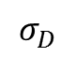
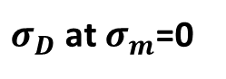
Goodman-Smith Diagram
σ
σ
max
B
A
A
R
σ
$$σ_{D}$$
R
m
a
e
$σ_{D}$ at $σ_{m}$=0
σ
σ
a
m
σ
min
45°

Slide 20
Ros diagram
R=-1/2
R=0
R=1/2
R=-1
σ
B
max
R=1
C
A
σ
min

Slide 21
Example: Goodman-Smith
Admissible stress amplitude N_{f}= 10⁵ cycles and σ_{m}=200MPa ?
σ_{max}~ 580 MPa
σ_{min}~ -180 MPa

Slide 22
Example: Haigh diagram
Admissible stress amplitude at R=0 with N_{f}=10⁵ cycles?
σ_{max}=400
σ_{m}=200
σ_{a}=200

Slide 23
Influence of loading mode
Tension
Rotative bending
Plane bending

Slide 24
Scale effect
Observation : for a given stress amplitude value, the higher the dimensions of the testpiece, the lower the fatigue strength.
Causes :
mechanical;
probabilistic.
Scale effect coefficient :
Determined on a reference sample with small dimensions

Slide 25
Scale effect: stress gradient
Plane bending
σ_{n}
h₁
σ_{n}
h₂
Difference in stress gradients:
small thickness ⇒ high gradient. The less loaded layers support the highly loaded surface layers;
high thickness ⇒ small gradient. All the surface layer are nearly loaded in a similar way ⇒ loss in fatigue resistance

Slide 26
Scale effect: probabilistic aspect
The larger the dimensions of a component (volume, area), the more likely it is to have defects that behave as privileged initiation sites

Slide 27
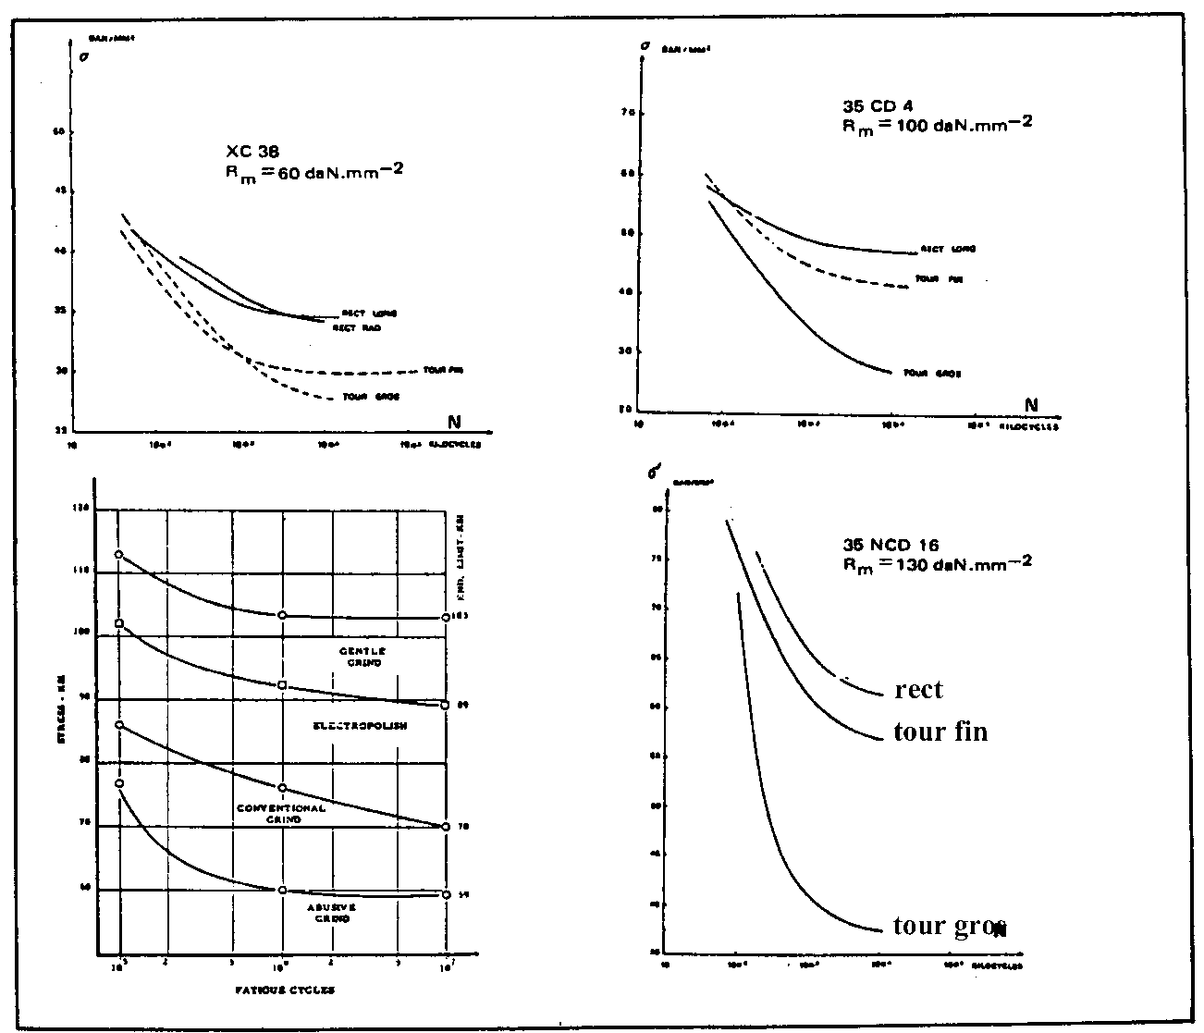
Influence of surface finishing

Slide 28
Influence of surface finishing
Surface finishing factor:
with :
fatigue limit with the surface finishing under consideration ;
fatigue imit with a reference surface finishing.

Slide 29
Residual stresses
Induced (on purpose or not) by:
Inhomogeneous plastic deformations (especially in the vicinity of stress concentrators)
Process
Surface treatment (shot blasting, shot peening, coating,…)
Expanded holes
Joining

Slide 30
Residual stresses near a stress concentrator
σ_{y} _{0,2%}
+
-
Plastic Zone
After unloading

Slide 31
Residual stresses induced by machining

Slide 32
Burnishing
The residual stresses introduced by burnishing induce a higher fatigue resistance

Slide 33
Expanded holes
Plastic zone with compressive residual stresses
Bore
Diameter of the pin larger than the diameter of the bore
σ_{res}
Pressure induced by the elastic medium
Before tension
After tension

Slide 34
Influence of environment
The fatigue life is lower in an active environment (air) than in an inert environment (vacuum)
Related effect: influence of frequency

